Slide 1
ENSE 470, Milestone 7
HELL'S Tech Support
Shawn Clake, Nikolas Lendvoy, Amruo Hasnoon
April 12,2018

Slide 2
Introduction
What team are you reviewing?
Byte This Software

Slide 3
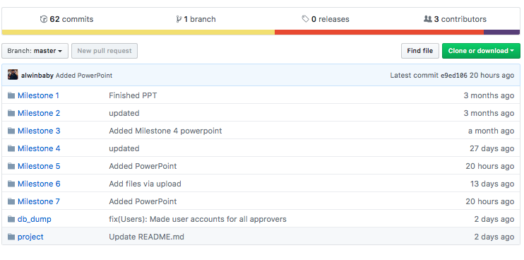
Team GitHub review

Slide 4
Team GitHub review
Does the team provide good documentation?
Overall, the team documentation was good. Folders were mostly well named and organized. Folders and files within the project folder get more difficult to follow. Could have better descriptions than “Updated”.
Is your team able to understand the file/folder names/structure (flow)?
Yes, everything was clear
Would your team be able to easily and quickly pick up where they left off?
- It would be hard since no one in our team had any experience using Node JS, but most of the programming seemed clean and well structured.

Slide 5
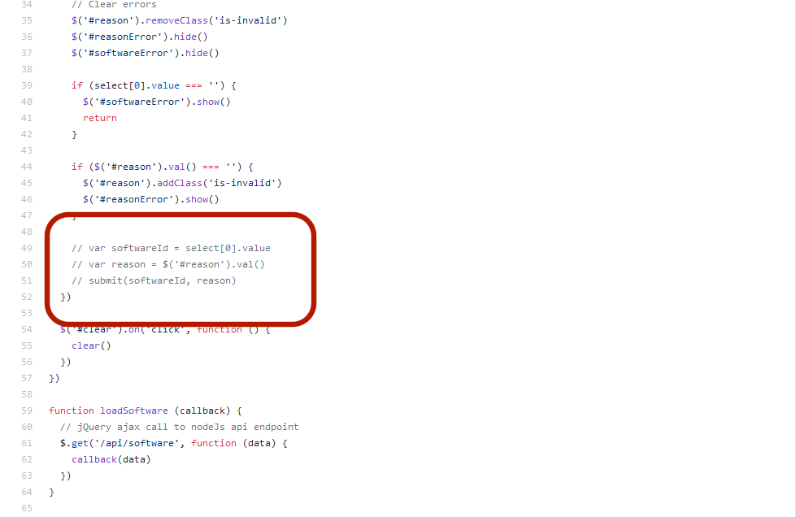
Do you have any comments/guidance for the team in this area?
- Change variables names to better imply their purposes ( ex: Application vs. App).
- Indicate the usage of "IMPORTANT" in CSS.
- Add more comments explaining the functionality of the codes.
- Remove unnecessary code and not leave them as comments.

Slide 6
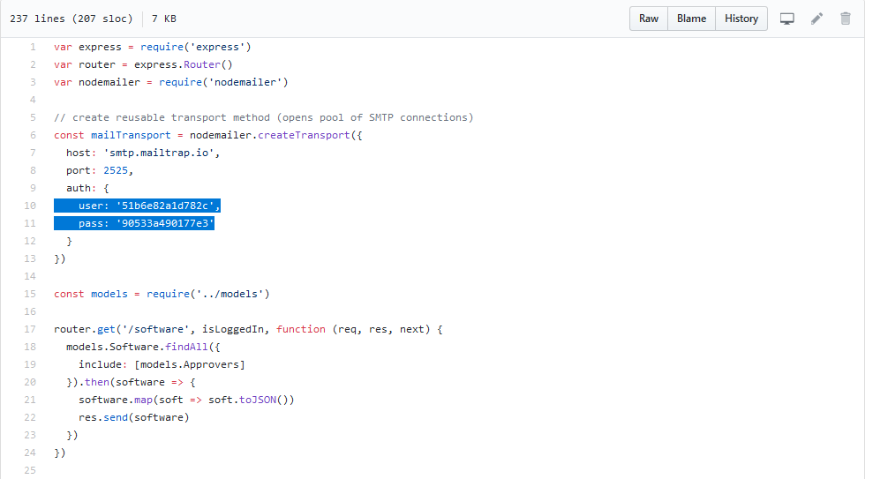
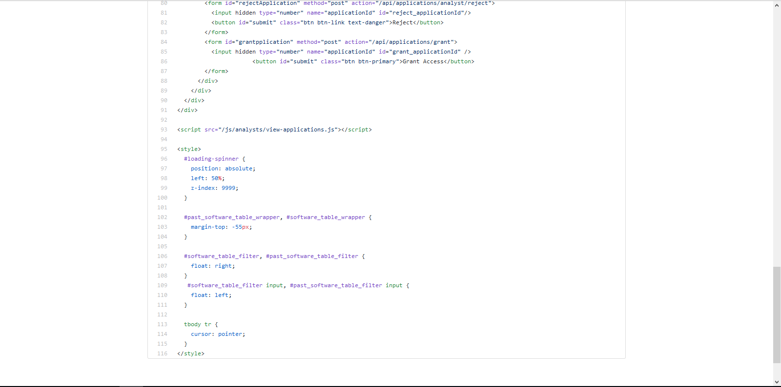
Remove the username and password form the source code.
Separate CSS code from HBS code (There are already CSS files).

Slide 7
Refactor review (High-level focus)
Is the team’s code obvious/readable for other programmers
There is a lack of documentation meaning it may be difficult to follow the program. We were not able to understand it all due to not knowing the language.
The program looked fairly well structured so we assume it would be easy to maintain.
Do all tests pass?
We could not find a full list of the team’s ATDDs
We were unable to run the program to test the ATDDs
Code smells
Given our lack of experience with Node JS and the lack of documentation we were unable to determine any smells, good or bad.

Slide 8
Design pattern discussion
Design patterns used
1. Decorator
Alerts on top of page after success/failed request
2. Model-View-Controller
View (HTML/CSS pages), Controller (JavaScript modules for each separate page),
Model (Node REST API)
3. Observer
Email notification
The patterns worked well and were used appropriately

Slide 9
Questions/Comments?
Byte This Software

Slide 10
Group reflection
How did you feel about this milestone? What did you like about it? What did you dislike?
Like -- It was a nice experience, we learned portions of a new language and different design patterns
Dislike -- We couldn’t fully understand the whole program.
What did you learn about yourself as you collaborated and worked through this milestone?
It is easier to give criticism than take it.
How will you use what you have learned going forward?
We will learn to accept criticism and grow from it rather than marry our first ideas
What “stuff & things” related to this milestone would you want help with?
Nothing

